Slide 1



Faster hologram generation by using Max- Depth-Range-Length method
MD SIFATUL ISLAM
Masters student, OIP lab, Chungbuk National University
Email : sifatul@CBNU.ac.kr

Slide 2



Table of contents
Motivation
Conventional Multiple Wavefront Recoding Plane (M-WRP) method
Proposed Max-Length-Depth-Range (MLDR) method
Results and Summary
Future work

Slide 3

Motivation
Point cloud of real objects => depth ranges => discreet distance between WRP and object points
Long computational time
Non- uniformity in color

Slide 4
Conventional Multiple Wavefront recording plane (M-WRP) method
M-WRP calculates CGH in following steps:
Depth range is created with fixed number of depth layers
WRP in the center of each depth range
The light wave from 3D objects is recorded respective WRP [Equation. 1]
Light wave from WRPs to CGH is diffracted calculation based on fast Fourier transform (FFT)
Depth range 1
WRP 1
Depth range 2
WRP 2
Depth range 3
WRP 3
Equation. 1
θ
Depth range k
WRP k
Equation. 2
Diffraction
CGH
Notes:
1. Tomoyoshi Shimobaba, Nobuyuki Masuda, and Tomoyoshi Ito, "Simple and fast calculation algorithm for computer-generated hologram with wavefront recording plane," Opt. Lett. 34, 3133-3135 (2009)

Slide 5
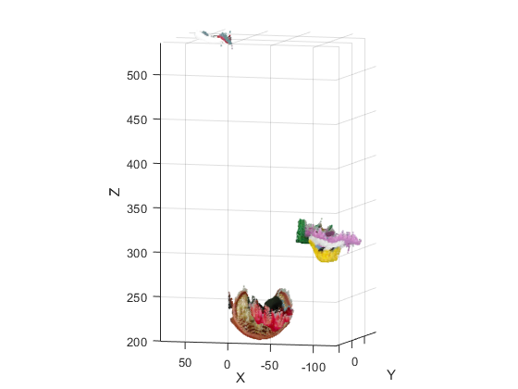
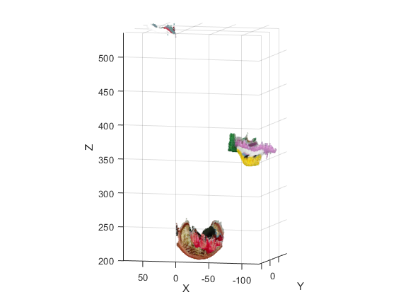
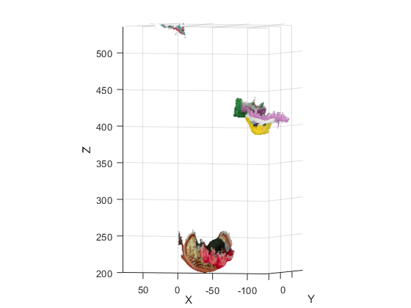
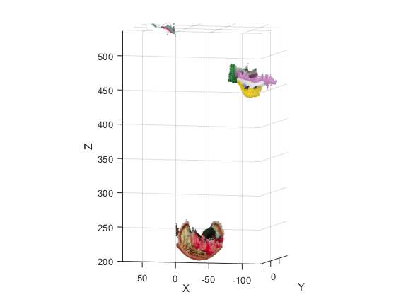
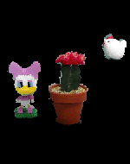
Position of WRPs and calculation time in conventional M-WRP method
Original image
no shift
5cm shift
10 cm shift
15 cm shift
Notes:
1. Tomoyoshi Shimobaba, Nobuyuki Masuda, and Tomoyoshi Ito, "Simple and fast calculation algorithm for computer-generated hologram with wavefront recording plane," Opt. Lett. 34, 3133-3135 (2009)

Slide 6
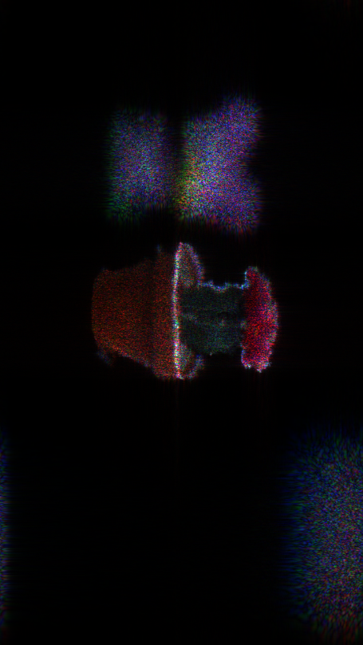
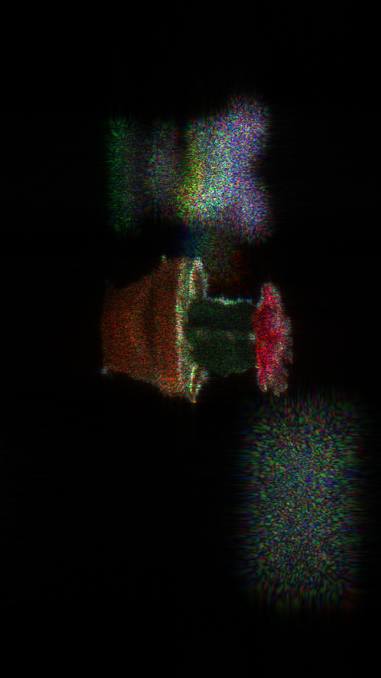
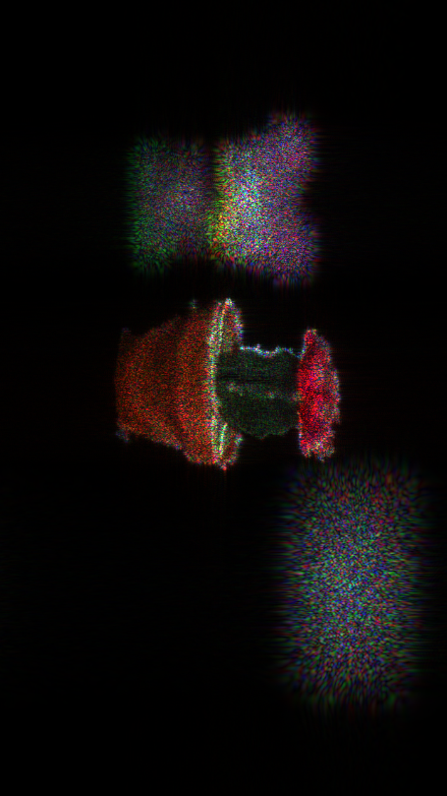
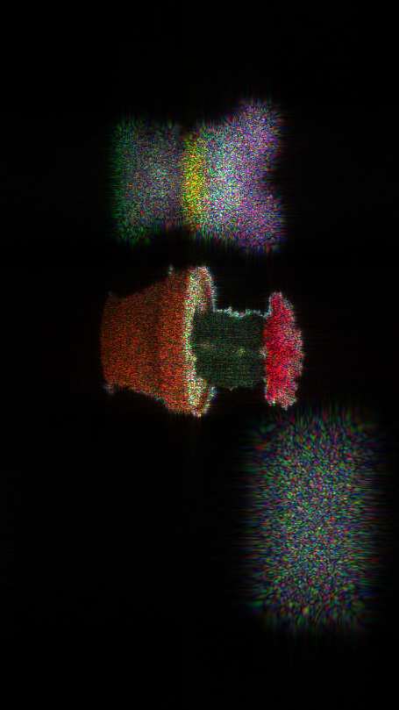

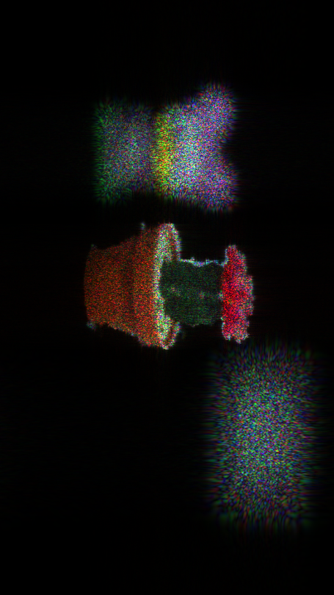
Color problem in M-WRP conventional method
2 WRP
4 WRP
8 WRP
64 WRP
16 WRP
32 WRP
Notes:
1. Tomoyoshi Shimobaba, Nobuyuki Masuda, and Tomoyoshi Ito, "Simple and fast calculation algorithm for computer-generated hologram with wavefront recording plane," Opt. Lett. 34, 3133-3135 (2009)

Slide 7
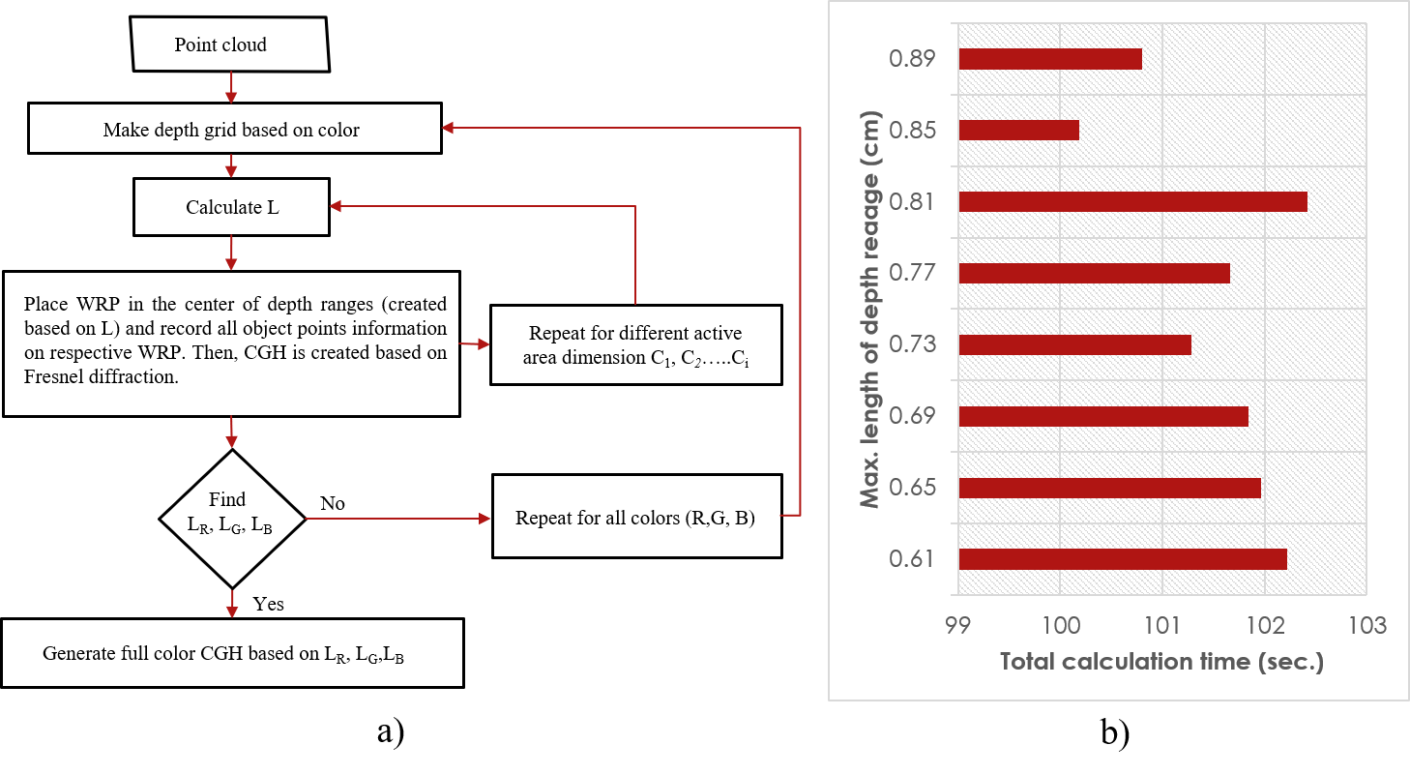
Max-Depth-Range-Length (MDRL) method
Depth range 1
WRP 1
L
Depth range 2
WRP 2
L
Depth range 3
WRP 3
L
θ
Depth range k-1
WRP k-1
L
Depth range k
WRP k
L
Diffraction
CGH
Equation. 3
Notes:
1. Tomoyoshi Shimobaba, Nobuyuki Masuda, and Tomoyoshi Ito, "Simple and fast calculation algorithm for computer-generated hologram with wavefront recording plane," Opt. Lett. 34, 3133-3135 (2009)

Slide 8
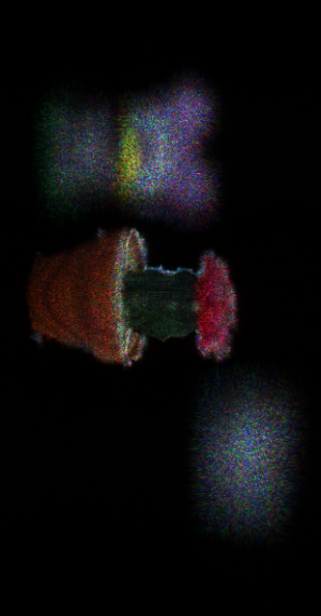
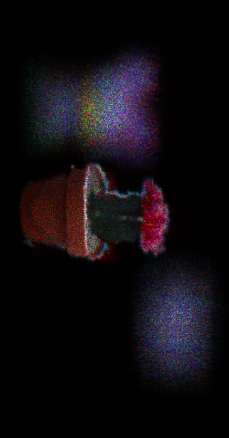
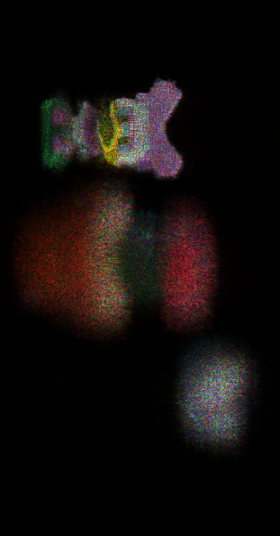
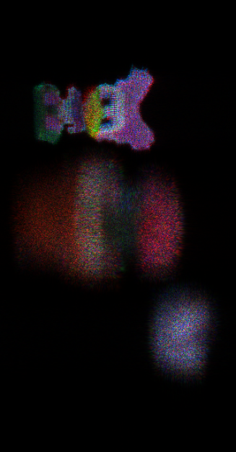
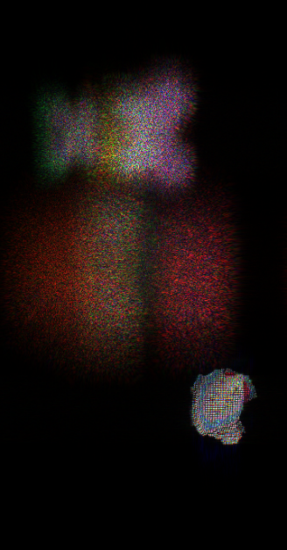
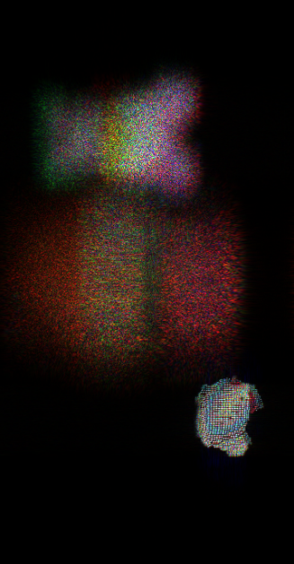
Result
Three objects |  | Calculation time(sec.)
Conventional M-Method | 2 WRPs ∕ color × 3 | 139.8135
 | 4 WRPs ∕ color × 3 | 136.7195
 | 8 WRPs ∕ color × 3 | 130.4805
 | 16 WRPs ∕ color x 3 | 131.4405
 | 32 WRPs ∕ color ×3 | 179.0325
 | 64 WRPs ∕ color × 3 | 195.0185
MLDR method | 4 WRPs (Red) 2 WRPS(Green) 3 WRPS (blue) | 93.441
a) Conventional M-WRP
b) MLDR method
Fig. 5 : Reconstructed image for Scene 1- cactus, mickey and chicken - using a) conventional M-WRP b) MLDR method
Notes:
1. Tomoyoshi Shimobaba, Nobuyuki Masuda, and Tomoyoshi Ito, "Simple and fast calculation algorithm for computer-generated hologram with wavefront recording plane," Opt. Lett. 34, 3133-3135 (2009)

Slide 9
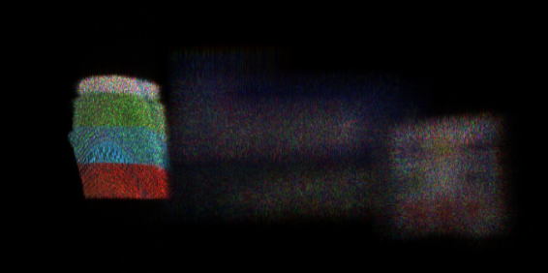
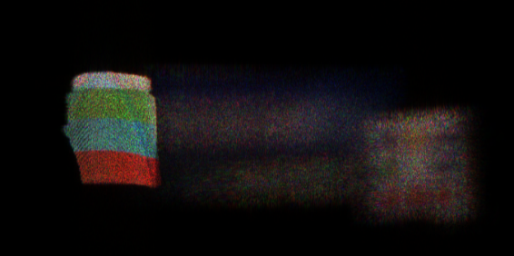

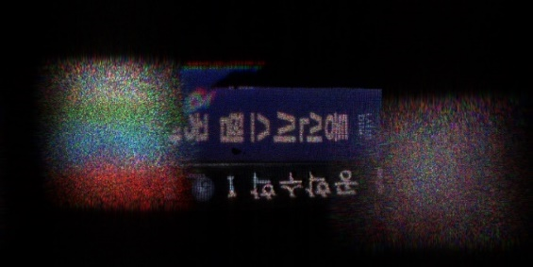
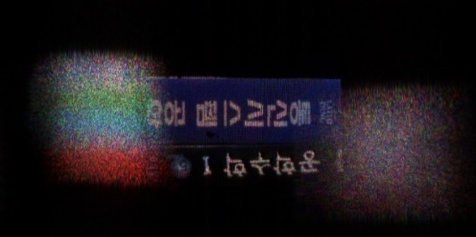
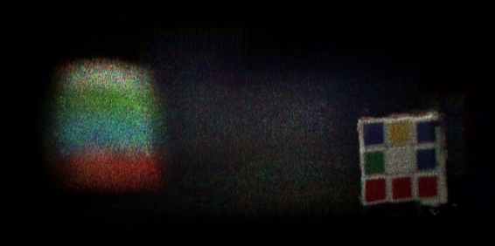
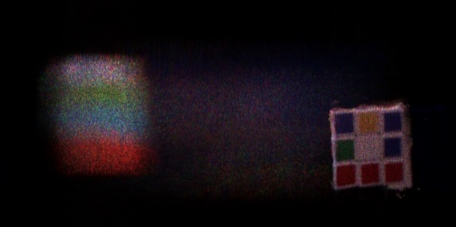
Result
Three items (1980 X1024) |  | Cal. Time (sec.)
Conventional M-WRP Method | 2 WRPs ∕ color × 3 | 390.893
 | 4 WRPs ∕ color × 3 | 156.906
 | 8 WRPs ∕ color × 3 | 181.009
 | 16 WRPs ∕ color × 3 | 198.155
 | 32 WRPs ∕ color × 3 | 214.048
 | 48 WRPs ∕ color × 3 | 223.189
Proposed method | 5 WRPs (red) 3 WRPS(green) 6 WRPS (blue) | 156.906
Original Image
a)
b)
Fig. 5 : Reconstructed image for scene 3 - cube, book, cup - using a) conventional M-WRP b) MLDR method
Conventional MWRP
Proposed method
Fig 2 : Depth ranges in conventional M-WRP

Slide 10
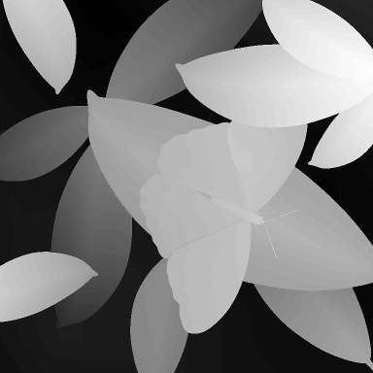
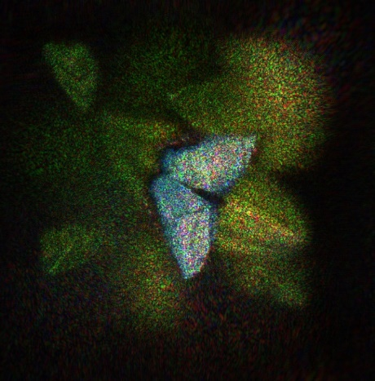
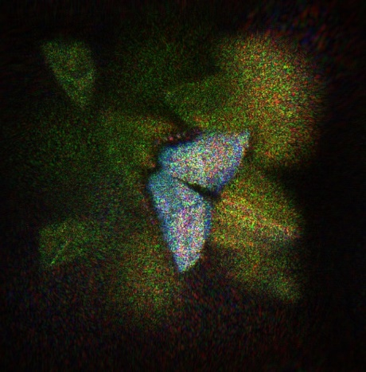

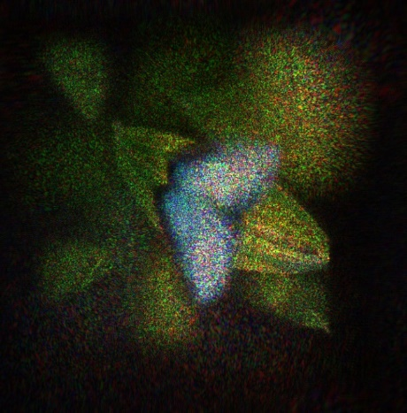
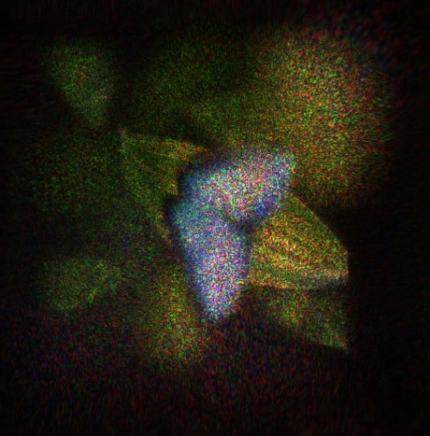
Result
Three items (1980 X1024) |  | Cal. time(sec.)
M-WRP Method | 2 WRPs ∕ color × 3 | 448.867
 | 4 WRPs ∕ color × 3 | 319.926
 | 8 WRPs ∕ color × 3 | 264.556
 | 16 WRPs ∕ color × 3 | 268.737
 | 32 WRPs ∕ color × 3 | 258.756
 | 64 WRPs ∕ color × 3 | 270.052
 | 128 WRPs ∕ color × 3 | 295.414
MLDR method | 11 WRPs (red) 11 WRPS(green) 8 WRPS (blue) | 220.488
a)
b)
c)
Fig. 5 : Reconstructed image for ‘Papilion’ using a) conventional M-WRP b) MLDR method
Conventional MWRP
Proposed method
Fig 2 : Depth ranges in conventional M-WRP

Slide 11
Results
Object (object point count) | Resolution | No. of depth layer | Conventional M-WRP |  |  | Proposed DM-WRP |  |  | improved/ time
 |  |  | No. of WRP | Time(sec.) | PSNR(dB) | No. of WRP | Time(sec.) | PSNR(dB)
Scene1 (35,263) | 1280X720 | 128 | 24 | 130.48 | 17.17 | 9 | 93.44 | 18.11 | 28.39%
Scene 2 (96,903) | 1280X720 | 112 | 12 | 248.08 | ?? | 9 | 213.11 | ?? | 24.98%
Scene 3 (84,549) | 1280X720 | 96 | 12 | 176.53 | 19.96 | 14 | 156.91 | 20.09 | 11.12%
Papilion (262,098) | 1280X720 | 255 | 96 | 258.76 | 17.72 | 30 | 220.49 | 17.72 | 14.79%
Table 1 : Calculation time and PSNR comparison between M-WRP and MLDR method

Slide 12
Thank you !!

Slide 13
Results
Object (object point count) | Resolution | No. of depth layer | Conventional M-WRP |  |  | Proposed DM-WRP |  |  | improved/ time
 |  |  | No. of WRP | Time(sec.) | PSNR(dB) | No. of WRP | Time(sec.) | PSNR(dB)
Scene1 (35,263) | 1280X720 | 128 | 24 | 130.48 | 17.17 | 9 | 93.44 | 18.11 | 28.39%
Scene 2 () | 1280X720 | 112 | 12 | 248.08 | ?? | 9 | 213.11 | ?? | 24.98%
Scene 3 () | 1280X720 | 96 | 12 | 176.53 | 19.96 | 14 | 156.91 | 20.09 | 11.12%
Papilion (262,098) | 1280X720 | 255 | 96 | 258.76 | 17.72 | 30 | 220.49 | 17.72 | 14.79%
Table 1 : Calculation time and PSNR comparison between M-WRP and MLDR method

Slide 14
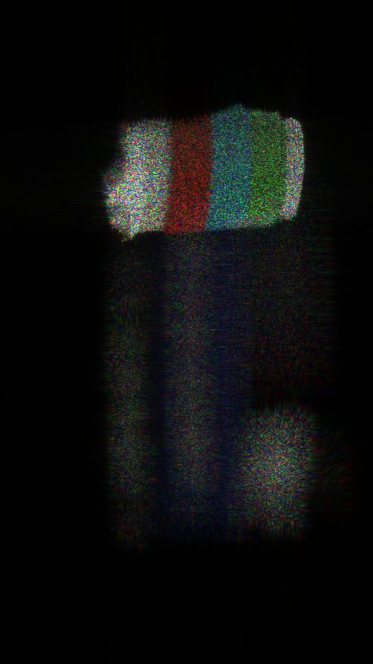
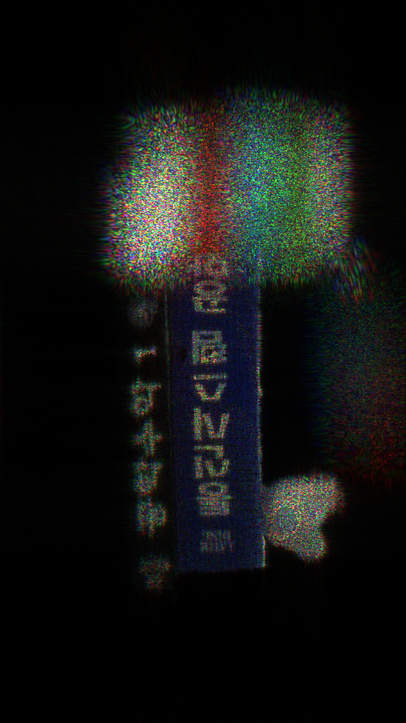
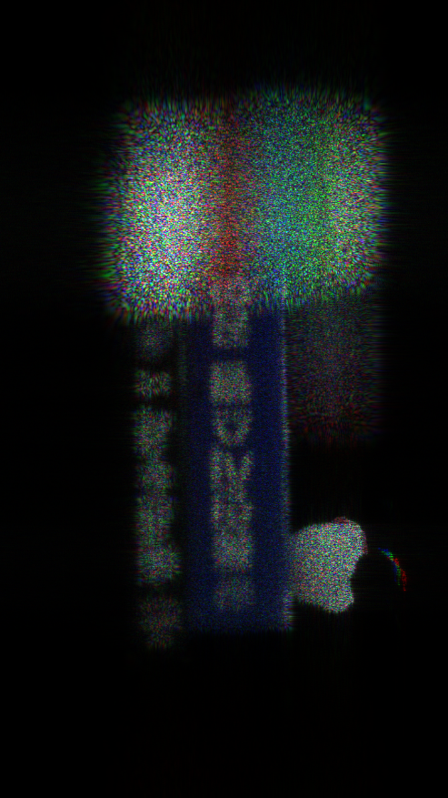
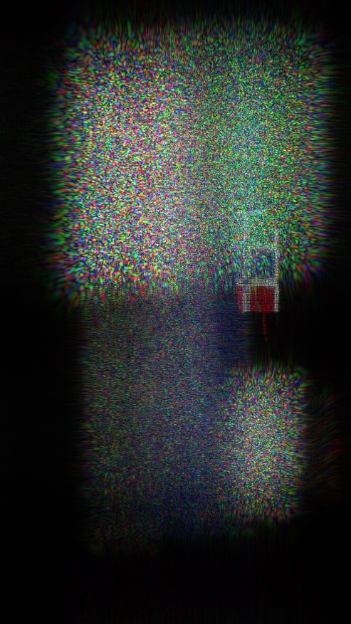


Slide 15
d
Depth
range 1
d
d
Depth
range 2
d
d
Depth
range 3
d
d
Depth
range 4
d
N(z₁) = 2
d
Depth
range 5
d
N(z₂) = 1
d
Depth
range 6
d
WRP 1
N(z₃) = 3
Depth
Range 1
d
Depth
range 7
d
Depth
range n
N(z₄) = 3
CGH
CGH
N(z₆) = 1
a)
b)
WRP 2
N(z₇) = 1
Depth
Range 2
N(z₆) = 1
N(z₇) = 2
WRP 1

Slide 16
Point cloud
Make depth grid based on color
Calculate L
Place WRP in the center of depth ranges (created based on L) and record all object points information on respective WRP. Then, CGH is created based on Fresnel diffraction.
Color < 3
Repeat for different active area dimension
Acquisition of real objects using depth camera
Find L (L_{R}, L_{G},L_{B}) that created CGH in minimum time
Repeat for all colors (R,G, B)
Active
area < k
Generate full color CGH based on L_{R}, L_{G},L_{B}

Slide 17
Point cloud
Make depth grid based on color
Point cloud
Make depth grid based on color
Calculate L
Calculate L
Place WRP in the center of depth ranges (created based on L) and record all object points information on respective WRP. Then, CGH is created based on Fresnel diffraction.
Place WRP in the center of depth ranges (created based on L) and record all object points information on respective WRP. Then, CGH is created based on Fresnel diffraction.
Repeat for different active area dimension
Repeat for different active area dimension
Find L_{R}, L_{G}, L_{B}
No
Repeat for all colors (R,G, B)
Find L that created CGH in minimum time (L_{R}, L_{G},L_{B})
Yes
Repeat for all colors (R,G, B)
Generate full color CGH based on L_{R}, L_{G},L_{B}
Generate full color CGH based on L_{R}, L_{G},L_{B}

Slide 18
Point cloud
Make depth grid based on color
Point cloud
Make depth grid based on color
Calculate L
Calculate L
Place WRP in the center of depth ranges (created based on L) and record all object points information on respective WRP. Then, CGH is created based on Fresnel diffraction.
Place WRP in the center of depth ranges (created based on L) and record all object points information on respective WRP. Then, CGH is created based on Fresnel diffraction.
Repeat for different active area dimension
Repeat for different active area dimension
Find L_{R}, L_{G}, L_{B}
No
Repeat for all colors (R,G, B)
Find L that created CGH in minimum time (L_{R}, L_{G},L_{B})
Yes
Repeat for all colors (R,G, B)
Generate full color CGH based on L_{R}, L_{G},L_{B}
Generate full color CGH based on L_{R}, L_{G},L_{B}

Slide 19
Point cloud
Make depth grid based on color
Calculate L
Place WRP in the center of depth ranges (created based on L) and record all object points information on respective WRP. Then, CGH is created based on Fresnel diffraction.
Repeat for different active area dimension C₁, C₂…..C_{i}
Find L_{R}, L_{G}, L_{B}
No
Repeat for all colors (R,G, B)
Yes
Generate full color CGH based on L_{R}, L_{G},L_{B}
a)
b)

Slide 20
Point cloud
Make depth grid based on color
Calculate L
Place WRP in the center of depth ranges (created based on L) and record all object points information on respective WRP. Then, CGH is created based on Fresnel diffraction.
Repeat for different active area dimension C₁, C₂…..C_{i}
Find L_{R}, L_{G}, L_{B}
No
Repeat for all colors (R,G, B)
Yes
Generate full color CGH based on L_{R}, L_{G},L_{B}
a)
b)

Slide 21
a)
b)

